Slide 1
Software Engineering BCA IV SEM
Chapter VIII
Managing Software Projects
Bijay Babu Regmi
bijay.regmi@deerwalk.edu.np

Slide 2
Software Project Management
Software Project Management (SPM) is a proper way of planning and leading software projects. It is a part of project management in which software projects are planned, implemented, monitored and controlled.
is distinct from traditional project management in that software projects have a unique lifecycle process that requires multiple rounds of testing, updating, and customer feedback. Most IT-related projects are managed in the agile style, in order to keep up with the increasing pace of business, and iterate based on customer and stakeholder feedback.
It is necessary for an organization to deliver quality product, keeping the cost within client’s budget constrain and deliver the project as per scheduled. Hence in order, software project management is necessary to incorporate user requirements along with budget and time constraints.

Slide 3
Continued….
Software Project Management consists of several different type of managements:
Conflict Management:
Conflict management is the process to restrict the negative features of conflict while increasing the positive features of conflict. The goal of conflict management is to improve learning and group results including efficacy or performance in an organizational setting. Properly managed conflict can enhance group results.
Risk Management:
Risk management is the analysis and identification of risks that is followed by synchronized and economical implementation of resources to minimize, operate and control the possibility or effect of unfortunate events or to maximize the realization of opportunities.
Requirement Management:
It is the process of analyzing, prioritizing, tracing and documenting on requirements and then supervising change and communicating to pertinent stakeholders. It is a continuous process during a project.

Slide 4
Continued….
Change Management:
Change management is a systematic approach for dealing with the transition or transformation of an organization’s goals, processes or technologies. The purpose of change management is to execute strategies for effecting change, controlling change and helping people to adapt to change.
Software Configuration Management:
Software configuration management is the process of controlling and tracing changes in the software, part of the larger cross-disciplinary field of configuration management. Software configuration management include revision control and the inauguration of baselines.
Release Management:
Release Management is the task of planning, controlling and scheduling the build in deploying releases. Release management ensures that organization delivers new and enhanced services required by the customer, while protecting the integrity of existing services.

Slide 5
Continued….
The success criteria for project management obviously vary from project to project but, for most projects, important goals are:
1. Deliver the software to the customer at the agreed time.
2. Keep overall costs within budget.
3. Deliver software that meets the customer’s expectations.
4. Maintain a happy and well-functioning development team.
However, software engineering is different from other types of engineering in a number of ways that make software management particularly challenging. Some of these differences are:
The product is intangible: A manager of a shipbuilding or a civil engineering project can see the product being developed. If a schedule slips, the effect on the product is visible—parts of the structure are obviously unfinished. Software is intangible. It cannot be seen or touched. Software project managers cannot see progress by simply looking at the artifact that is being constructed. Rather, they rely on others to produce evidence that they can use to review the progress of the work.

Slide 6
Continued….
Large software projects are often ‘one-off ’ projects: Large software projects are usually different in some ways from previous projects. Therefore, even managers who have a large body of previous experience may find it difficult to anticipate problems. Furthermore, rapid technological changes in computers and communications can make a manager’s experience obsolete. Lessons learned from previous projects may not be transferable to new projects.
Software processes are variable and organization-specific: The engineering process for some types of system, such as bridges and buildings, is well understood. However, software processes vary quite significantly from one organization to another. Although there has been significant progress in process standardization and improvement, we still cannot reliably predict when a particular software process is likely to lead to development problems. This is especially true when the software project is part of a wider systems engineering project.

Slide 7
Continued….
most managers take responsibility at some stage for some or all of the following activities:
Project planning: Project managers are responsible for planning, estimating and scheduling project development, and assigning people to tasks. They supervise the work to ensure that it is carried out to the required standards and monitor progress to check that the development is on time and within budget.
Reporting: Project managers are usually responsible for reporting on the progress of a project to customers and to the managers of the company developing the software. They have to write concise, coherent documents that abstract critical information from detailed project reports. They must be able to present this information during progress reviews.
Risk management: Project managers have to assess the risks that may affect a project, monitor these risks, and take action when problems arise.
People management: Project managers are responsible for managing a team of people. They have to choose people for their team and establish ways of working that lead to effective team performance.
Proposal writing: The first stage in a software project may involve writing a proposal to win a contract to carry out an item of work. The proposal describes the objectives of the project and how it will be carried out. It usually includes cost and schedule estimates and justifies why the project contract should be awarded to a particular organization or team.

Slide 8
Project Planning
Project planning is one of the most important jobs of a software project manager. As a manager, you have to break down the work into parts and assign these to project team members, anticipate problems that might arise, and prepare tentative solutions to those problems.
Project planning takes place at three stages in a project life cycle:
1. At the proposal stage, when you are bidding for a contract to develop or provide a software system. You need a plan at this stage to help you decide if you have the resources to complete the work and to work out the price that you should quote to a customer.
2. During the project startup phase, when you have to plan who will work on the project, how the project will be broken down into increments, how resources will be allocated across your company, etc. Here, you have more information than at the proposal stage, and can therefore refine the initial effort estimates that you have prepared.
3. Periodically throughout the project, when you modify your plan in light of experience gained and information from monitoring the progress of the work. You learn more about the system being implemented and capabilities of your development team. This information allows you to make more accurate estimates of how long the work will take. Furthermore, the software requirements are likely to change and this usually means that the work breakdown has to be altered and the schedule extended.

Slide 9
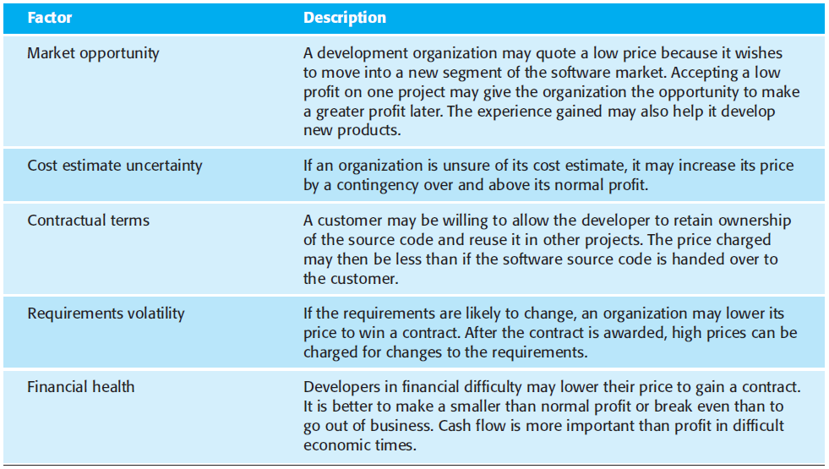
Software Pricing
In principle, the price of a software product to a customer is simply the cost of development plus profit for the developer.
In practice, however, the relationship between the project cost and the price quoted to the customer is not usually so simple.
When calculating a price, you should take broader organizational, economic, political, and business considerations into account, such as those shown in Figure below. You need to think about organizational concerns, the risks associated with the project, and the type of contract that will be used.
Figure: Factors affecting software pricing

Slide 10
Project Scheduling
is the process of deciding how the work in a project will be organized as separate tasks, and when and how these tasks will be executed
You estimate the calendar time needed to complete each task, the effort required, and who will work on the tasks that have been identified.
You also have to estimate the resources needed to complete each task, such as the disk space required on a server, the time required on specialized hardware, such as a simulator, and what the travel budget will be.
Both plan-based and agile processes need an initial project schedule, although the level of detail may be less in an agile project plan. This initial schedule is used to plan how people will be allocated to projects and to check the progress of the project against its contractual commitments.
In traditional development processes, the complete schedule is initially developed and then modified as the project progresses. In agile processes, there has to be an overall schedule that identifies when the major phases of the project will be completed. An iterative approach to scheduling is then used to plan each phase.

Slide 11
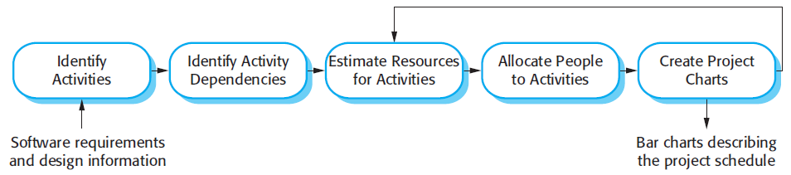
Continued….
Scheduling in plan-driven projects (Figure below) involves breaking down the total work involved in a project into separate tasks and estimating the time required to complete each task. Tasks should normally last at least a week, and no longer than 2 months.
Figure: The Project Scheduling Process

Slide 12
Estimation Techniques
Project schedule estimation is difficult. You may have to make initial estimates on the basis of a high-level user requirements definition. The software may have to run on unfamiliar computers or use new development technology.
The people involved in the project and their skills will probably not be known. There are so many uncertainties that it is impossible to estimate system development costs accurately during the early stages of a project. There are two types of technique that can be used to do this:
1. Experience-based techniques: The estimate of future effort requirements is based on the manager’s experience of past projects and the application domain. Essentially, the manager makes an informed judgment of what the effort requirements are likely to be.
2. Algorithmic cost modeling: In this approach, a formulaic approach is used to compute the project effort based on estimates of product attributes, such as size, and process characteristics, such as experience of staff involved.

Slide 13
Algorithmic Cost Modelling
Algorithmic cost modeling uses a mathematical formula to predict project costs based on estimates of the project size; the type of software being developed; and other team, process, and product factors.
An algorithmic cost model can be built by analyzing the costs and attributes of completed projects, and finding the closest-fit formula to actual experience.
Algorithmic cost models are primarily used to make estimates of software development costs.
Algorithmic models for estimating effort in a software project are mostly based on a simple formula:
Effort = A *Size^B *M
A is a constant factor which depends on local organizational practices and the type of software that is developed. Size may be either an assessment of the code size of the software or a functionality estimate expressed in function or application points. The value of exponent B usually lies between 1 and 1.5. M is a multiplier made by combining process, product, and development attributes, such as the dependability requirements for the software and the experience of the development team.

Slide 14
Continued….
Most algorithmic estimation models have an exponential component (B in the above equation) that is related to the size and complexity of the system. The more complex the system, the more these factors affect the cost. Therefore, the value of B usually increases with the size and complexity of the system.
All algorithmic models have similar problems:
1. It is often difficult to estimate Size at an early stage in a project, when only the specification is available. Function-point and application-point estimates are easier to produce than estimates of code size but are still often inaccurate.
2. The estimates of the factors contributing to B and M are subjective. Estimates vary from one person to another, depending on their background and experience of the type of system that is being developed.
Algorithmic cost models are a systematic way to estimate the effort required to develop a system. However, these models are complex and difficult to use.
There are many attributes and considerable scope for uncertainty in estimating their values. This complexity discourages potential users and hence the practical application of algorithmic cost modeling has been limited to a small number of companies.

Slide 15
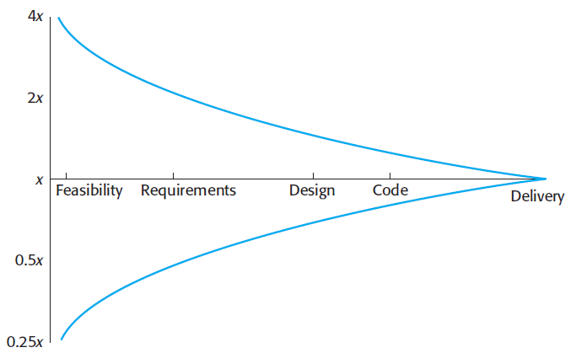
Continued….
If you use an algorithmic cost estimation model, you should develop a range of estimates (worst, expected, and best) rather than a single estimate and apply the costing formula to all of them.
Estimates are most likely to be accurate when you understand the type of software that is being developed, have calibrated the costing model using local data, or when programming language and hardware choices are predefined.
Figure: Estimate Uncertainty

Slide 16
COCOMO Model II
is an empirical model that was derived by collecting data from a large number of software projects
These data were analyzed to discover the formulae that were the best fit to the observations.
These formulae linked the size of the system and product, project and team factors to the effort to develop the system.
COCOMO II is a well-documented and nonproprietary estimation model.
The COCOMO II model takes into account more modern approaches to software development, such as rapid development using dynamic languages, development by component composition, and use of database programming.
The sub-models (Figure below) that are part of the COCOMO II model are:
1. An application-composition model: This models the effort required to develop systems that are created from reusable components, scripting, or database programming. Software size estimates are based on application points, and a simple size/productivity formula is used to estimate the effort required.

Slide 17
Continued….
2. An early design model: This model is used during early stages of the system design after the requirements have been established. The estimate is based on the standard estimation formula that I discussed in the introduction, with a simplified set of seven multipliers. Estimates are based on function points, which are then converted to number of lines of source code.
3. A reuse model: This model is used to compute the effort required to integrate reusable components and/or automatically generated program code. It is normally used in conjunction with the post-architecture model.
4. A post-architecture model: Once the system architecture has been designed, a more accurate estimate of the software size can be made. Again, this model uses the standard formula for cost estimation discussed above. However, it includes a more extensive set of 17 multipliers reflecting personnel capability, product, and project characteristics.

Slide 18
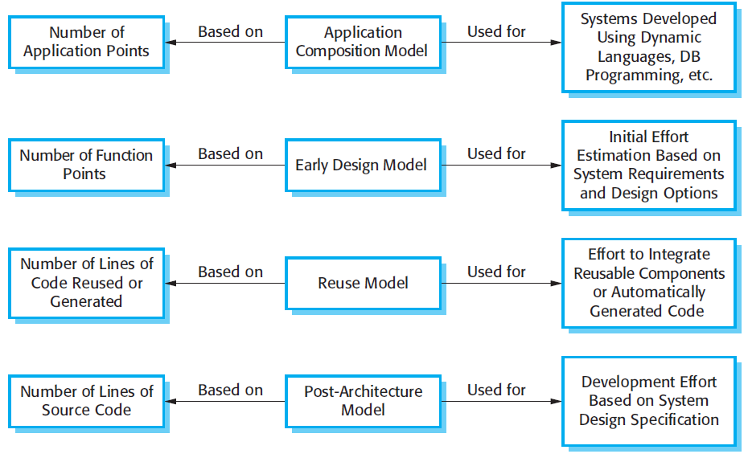
Continued…..
Figure: COCOMO Estimation Model

Slide 19
Risk Management
A risk is a potential problem. It’s an activity or event that may compromise the success of a software development project. Risk is the possibility of suffering loss, and total risk exposure to a specific project will account for both the probability and the size of the potential loss.
Risk Management is an important part in project planning activities. It involves identifying and estimating the probability of risks with their order of impact on the project. There are some steps which need to be followed in order to reduce risk. These steps are as follows:
Identify risks and their triggers
Classify and prioritize all risks
Craft a plan that links each risk to a mitigation
Monitor for risk triggers during the project
Implement the mitigating action if any risk materializes
Communicate risk status throughout project

Slide 20
Managing People
To explain some of the issues involved in selecting and retaining staff
To describe factors that influence individual motivation
To discuss key issues of team working including composition, cohesiveness and communications
To introduce the people capability maturity model (P-CMM) - a framework for enhancing the capabilities of people in an organization
People management factors:
Consistency- Team members should all be treated in a comparable way without favourites or discrimination.
Respect- Different team members have different skills and these differences should be respected.
Inclusion- Involve all team members and make sure that people’s views are considered.
Honesty- You should always be honest about what is going well and what is going badly in a project.

Slide 21
Selecting Staff
An important project management task is team selection.
Information on selection comes from:
- Information provided by the candidates.
- Information gained by interviewing and talking with candidates.
- Recommendations and comments from other people who know
or who have worked with the candidates.

Slide 22
Motivating People
An important role of a manager is to motivate the people working on a project.
Motivation is a complex issue but it appears that their are different types of motivation based on:
- Basic needs (e.g. food, sleep, etc.);
- Personal needs (e.g. respect, self-esteem);
- Social needs (e.g. to be accepted as part of a group).

Slide 23
Managing Groups
Most software engineering is a group activity
- The development schedule for most non-trivial software
projects is such that they cannot be completed by one person
working alone.
Group interaction is a key determinant of group performance.
Flexibility in group composition is limited
- Managers must do the best they can with available people.

Slide 24
The People Capability Maturity Model
Intended as a framework for managing the development of people involved in software development.
To improve organizational capability by improving workforce capability.
To ensure that software development capability is not reliant on a small number of individuals.
To align the motivation of individuals with that of the organization.
To help retain people with critical knowledge and skills.

Slide 25
P-CMM Levels
Five stage model
Initial - Ad-hoc people management
Repeatable - Policies developed for capability improvement
Defined - Standardized people management across the organization
Managed - Quantitative goals for people management in place
Optimizing - Continuous focus on improving individual competence and workforce motivation

